Slide 1
Two Sample Comparison and Bivariate Regression
Aaron McAdie

Slide 2
Topics
Replicates vs Repeated Measures
2 Sample Comparisons
simulation examples of S/N, α, power
Bivariate Linear Fits
statistical underpinnings
model evaluation (R², residuals, confidence intervals)
explanation vs prediction

Slide 3
Replication vs Repeated Measures
Replication – completely duplicating measurement with new samples
i.e. measuring 5 random people’s height
Repeated measures – measuring the same sample multiple times
i.e. measuring one person’s height 5 times
Replication captures sample variability and allows inference about a population, repeated measures capture test variability
Notes:
making an inference about the population that the sample was drawn from is the fundamental idea behind classical statistics

Slide 4
Two Sample Comparisons
Even with multiple data points it is easy to draw incorrect conclusions about whether or not samples are the same/similar
t-tests can protect against Type I error (false discovery) to a degree
increasing sample size decreases Type II error rate (failing to find an effect that is present)
simulations where underlying population parameters are known help to illustrate these concepts
Notes:
with simulations we can pull n = i random samples out of a hat containing all possible values, and compare those samples to another random draw

Slide 5
Two Sample Comparisons
Simulation 1
5 random samples drawn from two populations
population 1 ~ N(µ = 0.997, σ = 0.001, σ² = 1e-6)
population 2 ~ N(0.997, 1e-6)
t test is performed on two samples, pvals recorded
new set of random draws is generated, pvals recorded
simulation run 1000 times
proportion of p<0.05 calculated
Notes:
note sigma is test variability, less understanding of true population variance

Slide 6
Two Sample Comparisons
Simulation 1 (equal means, n=5)
-proportion of p<0.05 = 0.051
Notes:
false discovery rate converges on alpha with a large number of simulations
remember these are random draws from identical populations
this is exactly what a p value tells you – probability of seeing an effect this size by random chance (does not account for sampling bias, test error, etc)

Slide 7
Two Sample Comparisons
Simulation 2
5 random samples drawn from two populations
population 1 ~ N(0.997, 1e-6)
population 2 ~ N(0.998, 1e-6)
Notes:
kind of converse example, an actual difference in this case

Slide 8
Two Sample Comparisons
Simulation 2 (unequal means, n=5)
-proportion of p<0.05 = 0.281

Slide 9
Two Sample Comparisons
Simulation 3 (unequal means, n=10)
-proportion of p<0.05 = 0.554
Notes:
get more precise estimates of population parameters

Slide 10
Sample Size and Power
Power is a function of µ₁-µ₂, σ, n, α
table at right applies for µ₁=0.997, µ₂=0.998, σ=0.001, α=0.05
n | Power
5 | 0.281
10 | 0.554
20 | 0.864
30 | 0.975
simulations use data pulled from normal distributions and with common variance. Methods exist for unequal variances and non-parametric data.

Slide 11
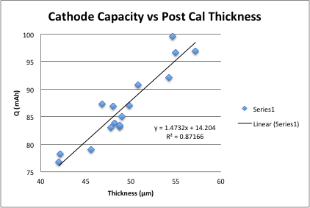
Linear Least Squares Regression

Slide 12
Linear Least Squares Regression
The line that minimizes the sum of the squared distances between each observation and the line
Estimate of slope term ->
Estimate of intercept term ->
Regression Model

Slide 13
R² and Beyond
R² is the percentage of variability in Y explained by the regression model
R² provides useful information but can be a misleading statistic
it is part of the story, but not the whole story

Slide 14
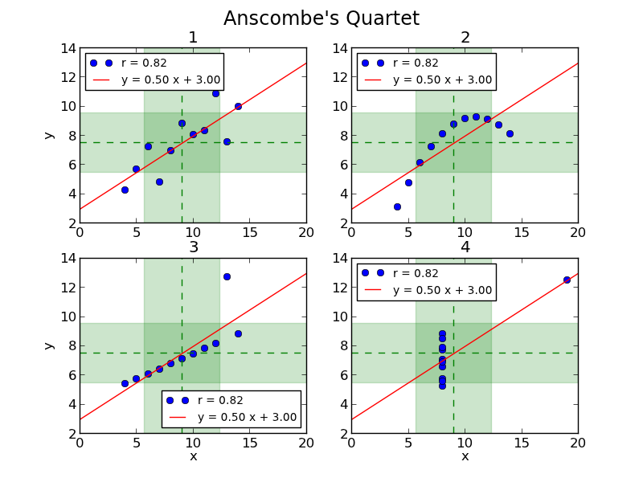
R² and Beyond
R² can be a misleading statistic
source: http://informatique-python.readthedocs.org/fr/latest/Exercices/anscombe.html

Slide 15
R² and Beyond
Tools to assess uncertainty and model fit
standard error of estimates
confidence intervals
residual diagnostics

Slide 16
Uncertainty of Parameter Estimates
Standard error is a measure of estimate precision. It is the standard deviation of the sampling distribution
standard error of regression slope:
allows for determination of practical significance vs statistical significance

Slide 17
Confidence and Prediction Intervals
A confidence interval around a fitted line represents uncertainty in model fit (parameter estimation)
A prediction interval around a fitted line represents uncertainty in predicting a new y_{i} given x_{i}
Both confidence and prediction intervals are the smallest in the center of the data
Prediction intervals are always wider than confidence intervals

Slide 18
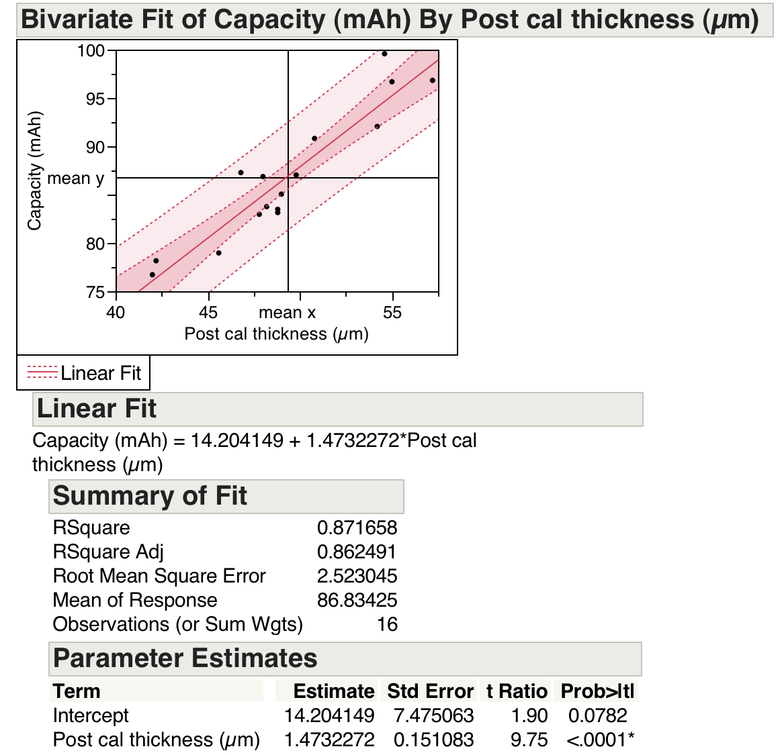
Confidence and Prediction Intervals

Slide 19
Residual Diagnostics
Residual diagnostics are an important part of model validation
Check to see that residuals are more or less normally distributed and look for patterns across your modeling space

Slide 20
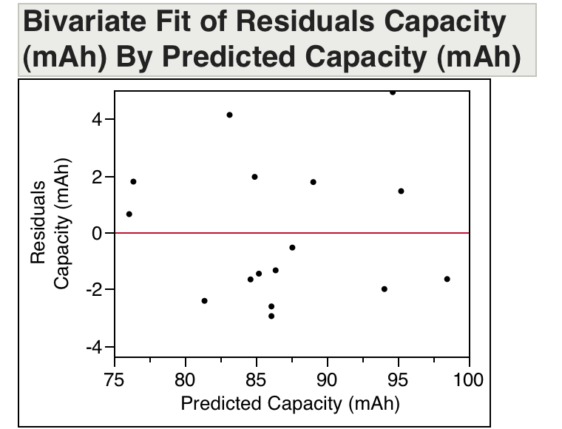
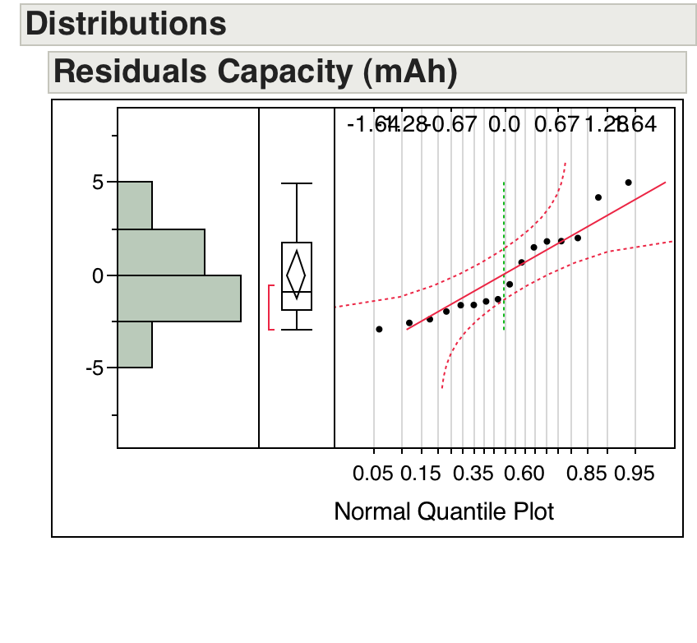
Residual Diagnostics

Slide 21
Residual Diagnostics
Notes:
Initially appears to be a great fit, case closed right?

Slide 22
Residual Diagnostics
Notes:
All model fit parameters look good.

Slide 23
Residual Diagnostics
Notes:
Plotting residuals vs predicted reveals a second (potentially) meaningful effect.

Slide 24
Follow-Up Questions
What does it look like if p-values are overlaid on simulation boxplots?
Does decreasing test error affect statistical power more than increasing sample size?
Is it better to run n=2 in 4 tests or n=8 in one test?
What is the interpretation of prediction intervals? If the y_{i+1} observation falls within the prediction interval, does that mean the regression model is correct?

Slide 25
Equal Means Simulation with P-values
Simulation 4 (µ₁=0.997, µ₂=0.997, σ=0.001, n=5)
-proportion of p<0.05 = 0.044

Slide 26
Population Variability, Sample Size, and Power
Simulation 4 (µ₁=0.997, µ₂=0.998, σ=0.001, n=5)
-proportion of p<0.05 = 0.287

Slide 27
Population Variability, Sample Size, and Power
Simulation 5 (µ₁=0.997, µ₂=0.998, σ=0.001, n=10)
-proportion of p<0.05 = 0.56

Slide 28
Population Variability, Sample Size, and Power
Simulation 5 (µ₁=0.997, µ₂=0.998, σ=0.0005, n=5)
-proportion of p<0.05 = 0.784

Slide 29
Population Variability, Sample Size, and Power
Halving variability has a larger effect on power than doubling sample size
Power is the probability of rejecting a null hypothesis (H_{o}: µ₁ = µ₂) when it is false
*assuming pooled variance and n₁=n₂
Power is proportional to 1/σ and ~n^{1/2}
not directly proportional to n^{1/2} because the critical t value also changes with n, although not much

Slide 30
Spreading Samples Across Multiple Tests
Is it better to run n=2 in 4 similar tests or n=8 in one test?
Statistically speaking running 4 tests with n=2 would quadruple the risk of a false discovery, and also give lower power for each individual test, so it might result in 8 samples of inconclusive or misleading data
If tests were different enough to justify, it could be possible to create a combined metric using weighting factors and then do a non-parametric test such as a Wilcoxon Rank Sum, however I’ve never seen this done so it might not be valid

Slide 31
Prediction Interval Interpretations
Prediction intervals, like confidence intervals have a somewhat tricky interpretation
if you collect n xy pairs from a population, construct a regression line and a 95% prediction interval, then collect an observation n+1, and do that over and over, that n+1 observation will fall within the prediction interval 95% of the time, on average
not representative of the distribution of future observations at a given x value
Prediction intervals are the safest when considered a plausible range for new data

